Slide 1
Foundations of Statistics for in ML &AI
Target outcome:
Participants stop treating statistics as magic and start seeing it as structured common sense.

Slide 2
Why statistics matters in AI and ML
Statistics is the science of extracting insight from data. It organises, analyses and interprets information to uncover patterns and make decisions under uncertainty.
Key messages • ML models are opinions expressed in math: modern ML is built on top of statistical methods • Statistics is how we measure uncertainty and risk • Most AI failures are statistical misunderstandings, not model failures
It helps in understanding data distribution, variability and selecting the most useful features.
It is used to validate model results and make decisions under uncertainty using hypothesis tests, confidence intervals and Bayesian methods.
Notes:
Two models with the same accuracy behave very differently in deployment. Why? Distribution shift and variance: Because accuracy is an average, while deployment exposes models to changing data distributions and different levels of variance.

Slide 3
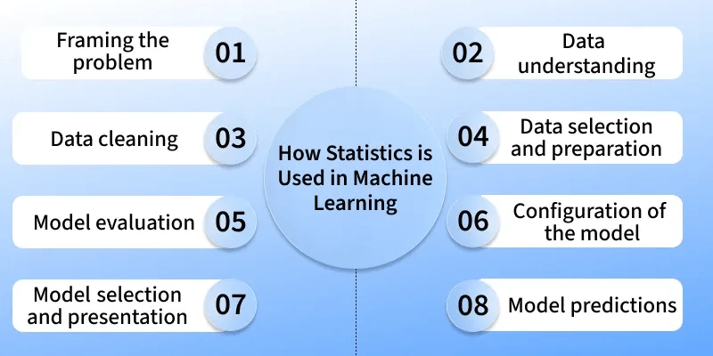
Why statistics matters in AI and ML
Notes:
Two models with the same accuracy behave very differently in deployment. Why? Distribution shift and variance: Because accuracy is an average, while deployment exposes models to changing data distributions and different levels of variance.

Slide 4
Descriptive statistics: Understanding the basics
Before training models, we perform exploratory data analysis (EDA), a process that relies on descriptive statistics to summarise key characteristics of the data.
These summaries inform us about;
the central tendency and variability of each feature,
helping identify outliers,
data quality issues, and
preprocessing needs.
Understanding these properties is a prerequisite for building effective models and choosing appropriate machine learning algorithms.
Notes:
Two models with the same accuracy behave very differently in deployment. Why? Distribution shift and variance: Because accuracy is an average, while deployment exposes models to changing data distributions and different levels of variance.

Slide 5
Descriptive Statistics
Mean (The Sensitive Average) | Median (The Stubborn Middle) | Mode (The Crowd Favourite)
Simple Summary: The balance point of the data where every value has a say. It is the arithmetic average of values. Common in measuring centrality and in loss functions like mean squared error (MSE). | Simple Summary: The literal middle value when data is sorted. It doesn't care about the size of the numbers at the ends; it only cares about their position. More robust to outliers than the mean. | Simple Summary: The most frequent value or category i.e. the most frequently occurring value or majority voting (as in some ensemble methods).
How/Where Used: Used when data is symmetric and "normal" (no crazy spikes). | How/Where Used: Used when data is "skewed" or has extreme outliers. | How/Where Used: Used for categorical data where math doesn't apply.
Example: Calculating the average height of students in a classroom. If customer purchase values are increasing, the mean detects shifts in behaviour. | Example: Reporting "Median Household Income" (because one billionaire would ruin the mean). In income data, the median better reflects a “typical” case in the presence of skewed wealth. | Example: Determining the most popular t-shirt size (Small, Medium, or Large) in an inventory. Finding the most common browser used by site visitors.
Practitioner Insight: In ML, we use Mean to normalise features so they all sit on a similar scale. | Practitioner Insight: Use the median to fill in missing data (imputation) when your dataset has outliers you don't want to delete.

Slide 6
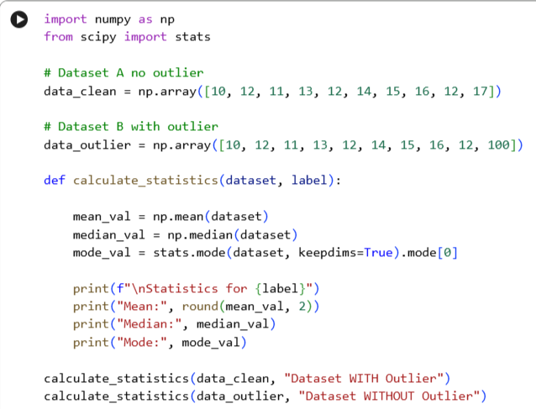
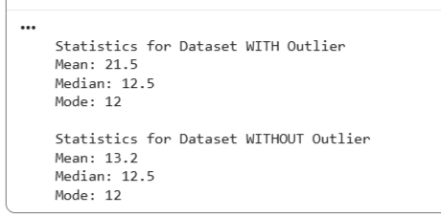
Descriptive Statistics

Slide 7
Descriptive Statistics
Variance & Standard Deviation (The "Nervous Energy") If the Mean is the anchor then Variance and Standard Deviation describe how much the data is trying to pull away from that anchor.
Variance: The "Raw Math Engine" | Standard Deviation: The "Back to Reality" Ruler
It's the squared of the average of how far every point is from the center, i.e., the mean of squared deviation from the mean | Measures how spread out the values are from the mean. The square root of Variance. It brings back into the original units we understand (dollars, centimeters, etc.)
Why we square it: If we didn't square the distances, the negative numbers (points below average) and positive numbers (points above average) would cancel each other out to zero. Squaring makes everything positive and "punishes" outliers—making big gaps look even bigger. | A low SD implies that the data is "calm", data points are clustered near (hugging) the mean, while a high SD indicates the data is "frantic", greater variability. The data points are scattered everywhere (High risk/unpredictability).
The Catch: Because we squared everything, the units are weird (e.g., "squared dollars" or "squared centimeters"). It’s hard to visualize.

Slide 8
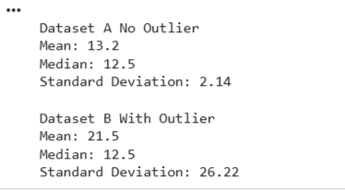
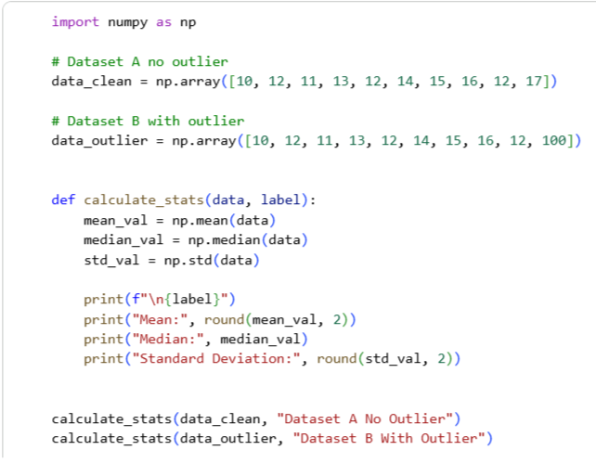
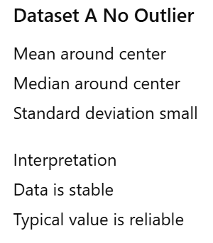
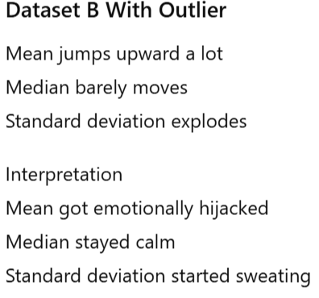
Descriptive Statistics

Slide 9
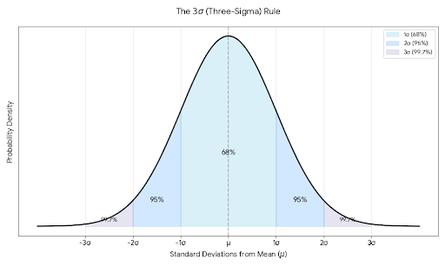
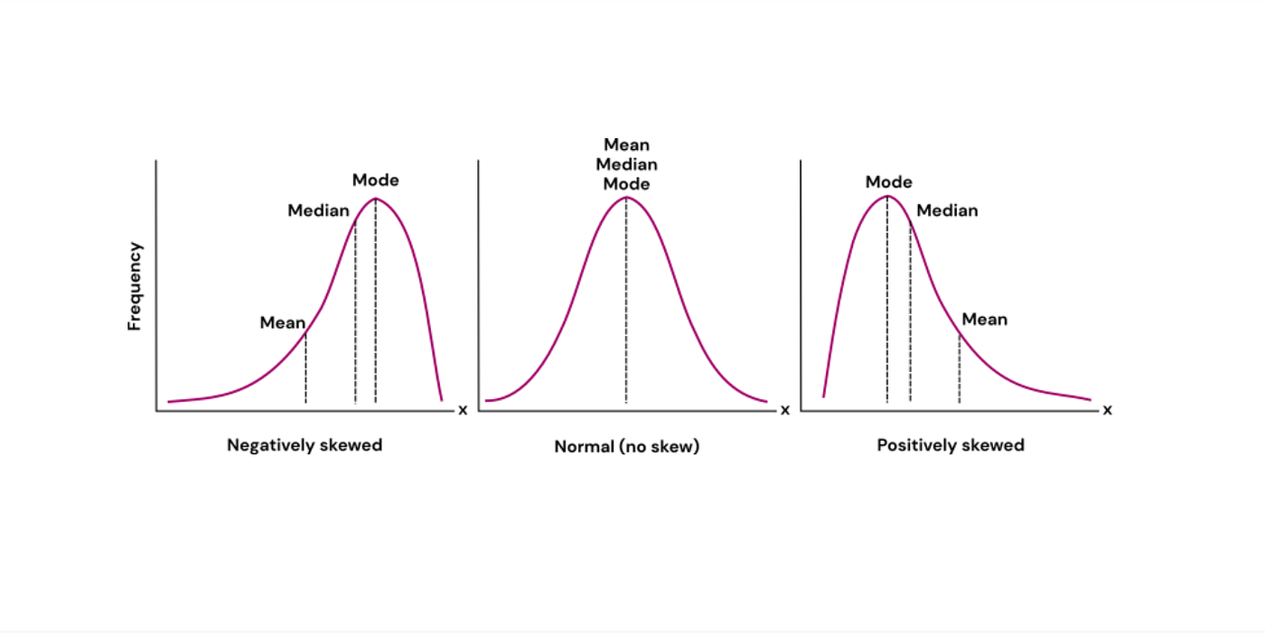
Descriptive Statistics

Slide 10
Probabilities: The language of uncertainty
Modelling by using machine learning exists because of uncertainty.
If we could perfectly map inputs to outputs, there would be no need for models. But real-world data is messy, incomplete and noisy—so we model likelihoods instead of certainties.
Learning about probabilities lays the fundamentals of everything machine learning and artificial intelligence (AI). Theories in probabilities allow us to understand the data we used to model in a beautiful and elegant way.
It plays a critical role in modelling uncertainties in ML models predictions, and helps us quantify likelihood, probability and certainties for a statistical model so we can confidently measure the outcome models we create.

Slide 11
Basics Terminologies
Random variable: A numerical representation of an outcome of a random phenomenon. It's a variable whose possible values are numerical outcomes of a random process.
Discrete random variable: A random variable that can take on a finite or countably infinite number of distinct values. For example, the outcome of a coin flip (Heads = 1, Tails = 0), or the number of spam emails received in an hour.
Continuous random variable: A random variable that can take on any value within a given range. For example, the height of a person, the temperature in a room or the amount of rainfall.
Event: A set of one or more outcomes from a random process. For example, rolling an even number on a die (outcomes: 2, 4, 6) or a customer churning.
Outcome: A single possible result of a random experiment. For example, flipping a coin yields either "Heads" or "Tails."

Slide 12
Probabilities: Basic Terminologies
Probability P(A): A numerical measure of the likelihood that an event A will occur, ranging from 0 (impossible) to 1 (certain).
Conditional probability P(A|B): The probability of event A occurring, given that event A has already occurred. This step is crucial in ML, as we often want to predict an outcome given specific features.
Probability is a measure of how likely an event is to happen, from 0 (impossible) to 1 (certain). So, in machine learning, it often takes the form of conditional probability
Example: A logistic regression model might say
Given age = 45, income = N80,000, and prior history of churn,
the probability of churn is 0.82.”
This example doesn’t mean that the customer will churn—it’s a belief based on the statistical patterns in the training data.

Slide 13
Distributions: Modelling how data behave
A probability distribution is a mathematical function that describes the possible values and likelihoods that a random variable can take within a particular range.
Understanding distributions is crucial in ML because data rarely exists as single, isolated points; it has a structure and a shape.
Discrete distribution: Applies to variables that take on distinct, countable values (for example, coin flips, word counts).
Continuous distribution: Applies to variables that can take any value within a range (for example, height, weight, time).
Making the right assumptions about your data's distribution is critical—many machine learning algorithms rely on these assumptions for both model selection and interpretation.
Incorrect assumptions can lead to biased estimates, misaligned loss functions and ultimately, poor generalization or invalid conclusions in real-world applications.

Slide 14
Distributions: Modelling how data behave
Probability distributions underpin:
Error modelling: Assumptions about residuals in regression (often Gaussian).
Loss functions: MSE corresponds to Gaussian assumptions; cross-entropy to Bernoulli or logistic.
Model design: Classification targets are often modelled through Bernoulli; latent variables in deep generative models use Gaussian priors.
Generative AI: Sampling from learned high-dimensional distributions is fundamental to models like generative adversarial networks (GAN) and VAEs.

Slide 15
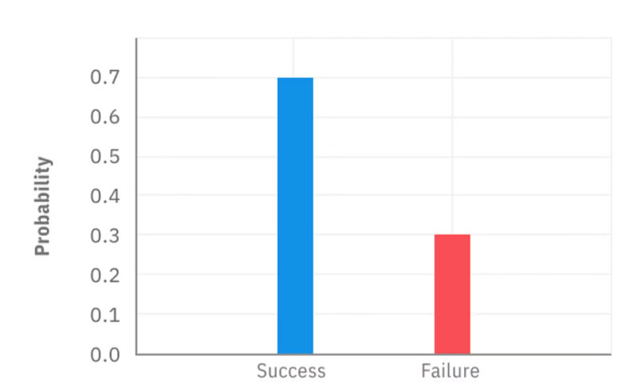
Example of discrete distribution: Bernoulli trials
The Bernoulli distribution models the probability of success or failure in a single trial of a discrete random event.
That is, it only has two outcomes: 1 (success) or 0 (failure). It's the simplest type of distribution used in statistics, yet it forms the foundation of many classification problems in machine learning.
For example, if you were to flip a coin 10 times, and you get 7 heads (success) and 3 tails (failure), the probability mass function (PMF) can be graphed as:

Slide 16
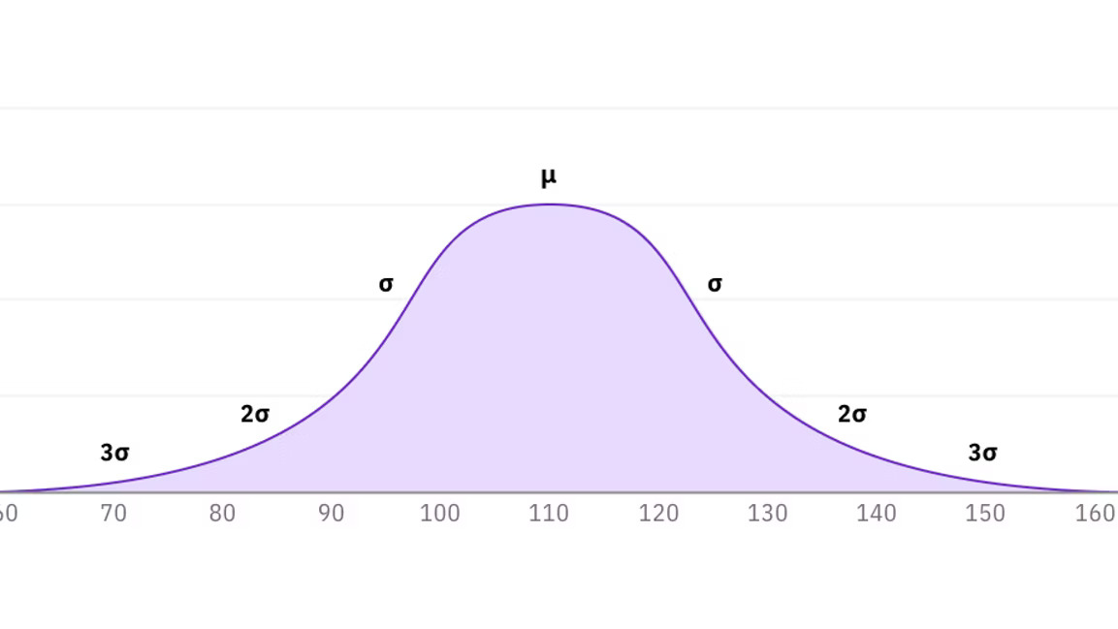
Example of continuous distribution: Gaussian (normal) distribution
The normal distribution describes a continuous random variable whose values tend to cluster around a central mean, with symmetric variability in both directions.
It's ubiquitous in statistics because many natural phenomena (height, test scores, measurement errors) follow this pattern, especially when aggregated across samples.
Imagine you record the heights of 1,000 adults. Plotting this data reveals a bell-shaped curve: most people are close to the average, with fewer at the extremes. This shape is captured by the probability density function (PDF) of the normal distribution.

Slide 17
Hypothesis Testing
Hypothesis testing is a method that compares two opposite assumptions about a population and uses data from a sample to determine which assumption is more likely to be true.
Null (H₀) vs. Alternative (H_{a}) :
H₀ assumes there is no effect or relationship in the population.
H_{a} suggests there’s an effect or relationship in the population.
Type I and Type II Errors:
Type I error is rejecting a true null hypothesis
Type II is failing to reject a false null hypothesis.
p-values: Measure the probability of obtaining the observed results under the null hypothesis.
The "Surprise Meter." If the H₀ is true, how weird is our data?
Small p-value (< 0.05): "This is too weird to be a coincidence. Reject H₀."
Large p-value (> 0.05): "There's a 50% chance this size difference happened by random luck. Keep H₀."

Slide 18
Confidence Intervals
Estimation is the process of making inference on unknown population parameters from sample data.
Point estimate is a single value that represents our best approximate value for an unknown population parameter.
Interval estimate is a range of values that is likely to contain the true value of a population parameter.
A confidence interval is an estimate of the range in which the true population mean is likely to lie. It is based on the sample mean and standard deviation and provides a measure of the uncertainty in the estimate.
Wide interval: " The estimate is too uncertain, so it could be anything."
Narrow interval: "The estimate is very reliable."

Slide 19
The Testing Toolbox
Test | When to Use it | Example
t-Test | Small sample, unknown variance. | Comparing the test scores of Class A vs. Class B.
z-Test | Large sample (n > 30), known variance | Testing if the average height of a whole country is exactly 175cm.
ANOVA | Comparing 3+ groups. | Do three different diets result in different weight loss amounts?
Chi-Square | Categorical data (Labels). | Is there a link between "Gender" and "Preference for Sci-Fi movies"?
t-Tests and z-Tests: Compare means to assess statistical significance.
ANOVA (Analysis of Variance): Compares means across multiple groups to determine if they differ significantly.
Chi-Square Tests: Assess the association between categorical variables.

Slide 20
Covariance vs Correlation & Correlation vs. Causation
Covariance vs Correlation in ML
Covariance:
Measures whether two variables move together.
Positive means they increase together. Negative means one increases while the other decreases.
Covariance tells you direction of relationship, but the scale depends on units, so the number itself is hard to interpret.
Correlation:
Is a standardized version of covariance.
It measures both direction and strength, always between minus one and one.
Correlation lets you compare relationships across features and decide which variables are more strongly related to a target or to each other.
Correlation vs Causation in ML
Correlation does not imply causation.
Models learn correlations, not causes.
A feature can improve predictions without being the true driver.
Risk: Using correlated but non causal features can break models when data distributions change.

